Slide 1



Data Science and Machine Learning
Bootcamp
SAGEMAKER

Slide 2
Running Code
Running code in our Machine can be quite intensive, especially for Machine Learning.
What if we could get the code to run on ”another machine” so that we could go on with our lives?
Running code on the cloud allow us to do that
For that, lets explore AWS SageMaker
*Note: there is much more to the cloud than this that we will learn near the end of the course. We are learning SageMaker because it is good for you to run code during the course
Welcome

Slide 3

SageMaker
AWS SageMaker is a product created by amazon to run Jupyter Notebooks on “another computer” (owned by Amazon). It is great for data professionals, as the front end is Jupyter, so something you are used to.
Lets see what we need to do
Welcome

Slide 4
Steps the account
Go to AWS
Create an account
You will need to input: Name, (real) Email, Credit Card (Revolut Works), (real) Phone Number
Select the Basic Support (Free) plan
Welcome

Slide 5
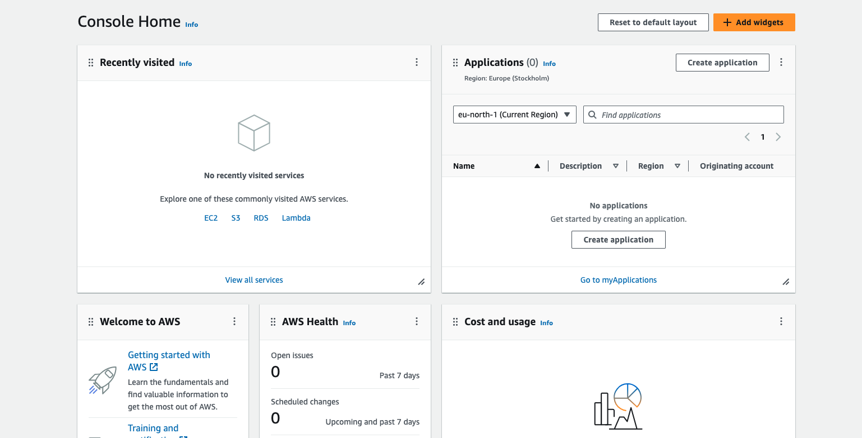
Login and run the code
Go to AWS
Log in
Welcome

Slide 6
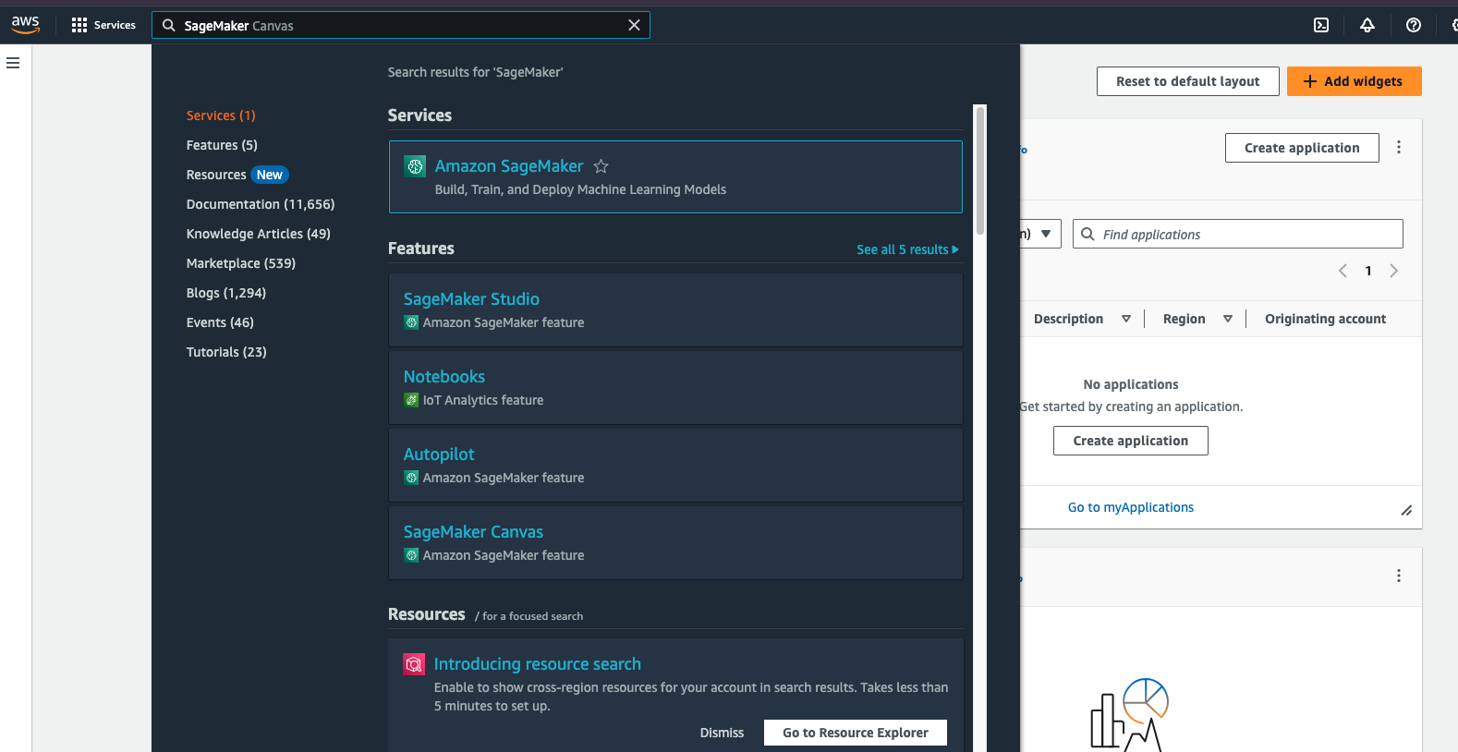
Login and run the code
Go to AWS
Log in
Search “SageMaker
Welcome

Slide 7
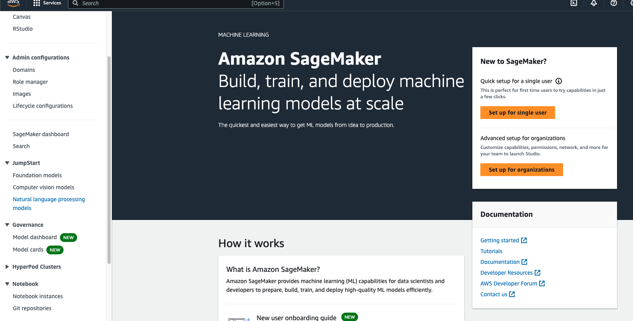
Login and run the code
Go to AWS
Log in
Search “SageMaker
Go to Notebook instances
Welcome

Slide 8
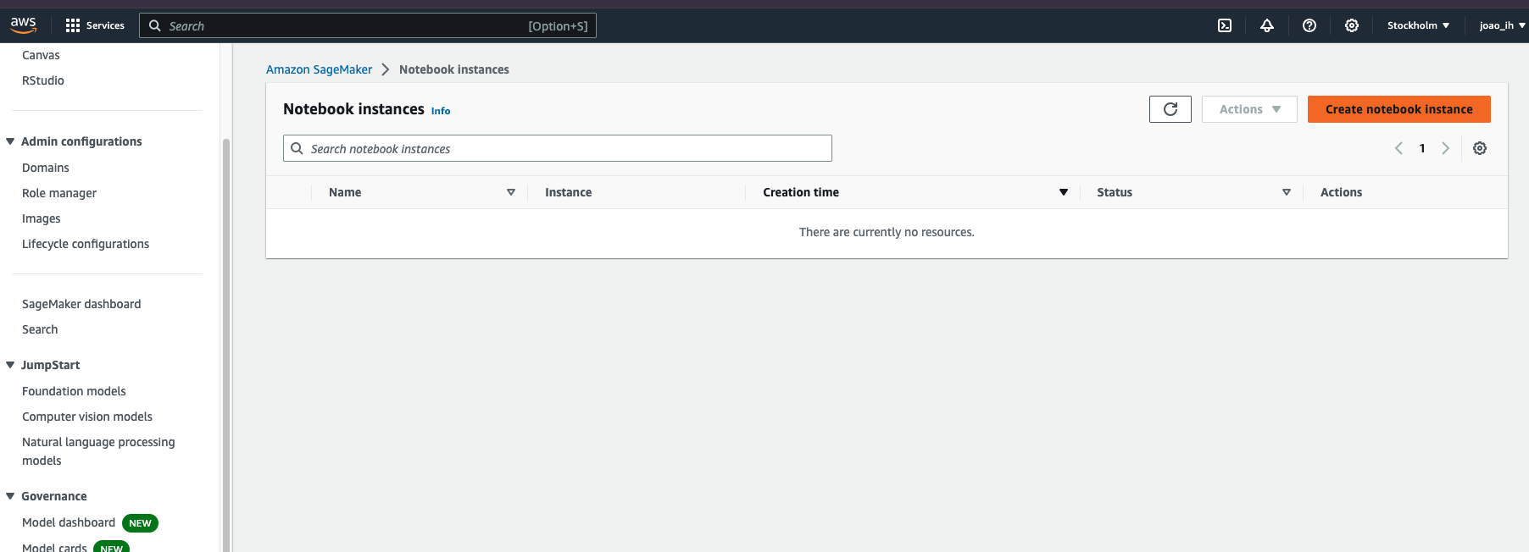
Login and run the code
Go to AWS
Log in
Search “SageMaker
Go to Notebook instances
Create notebook instance
IMPORTANT – THIS COSTS MONEY (5cents/h, when the instance is on)
IronHack cannot be responsible for what students do in their AWS accounts
(See last slide: you have 250h/month free in the beginning)
Welcome

Slide 9
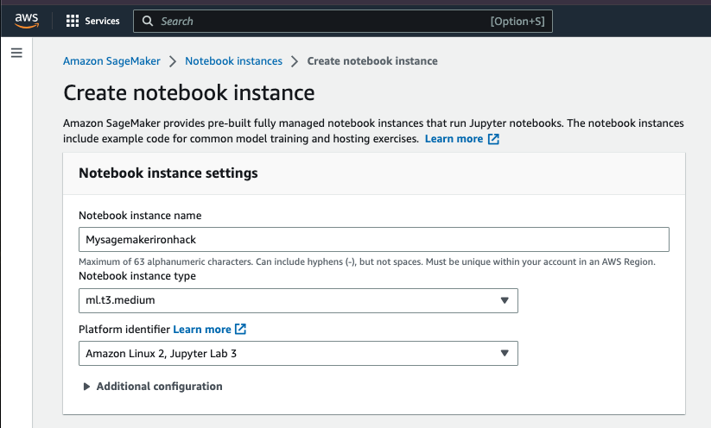
Login and run the code
Go to AWS
Log in
Search “SageMaker
Go to Notebook instances
Create notebook instance
Give it a name;
Welcome

Slide 10
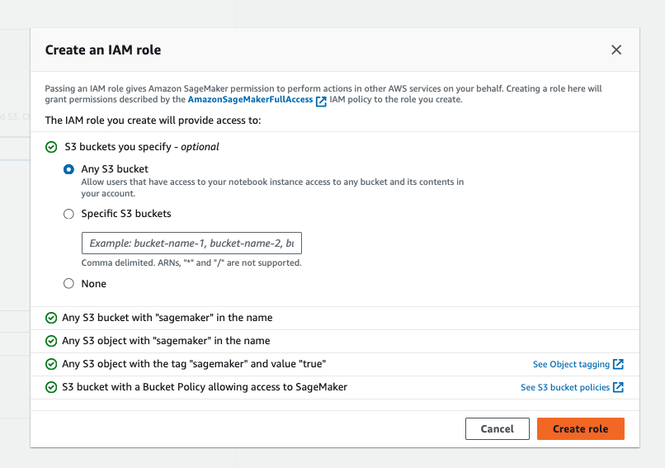
Login and run the code
Go to AWS
Log in
Search “SageMaker
Go to Notebook instances
Create notebook instance
Give it a name
(First time) create na IAM role
All other defaults are ok
Welcome

Slide 11
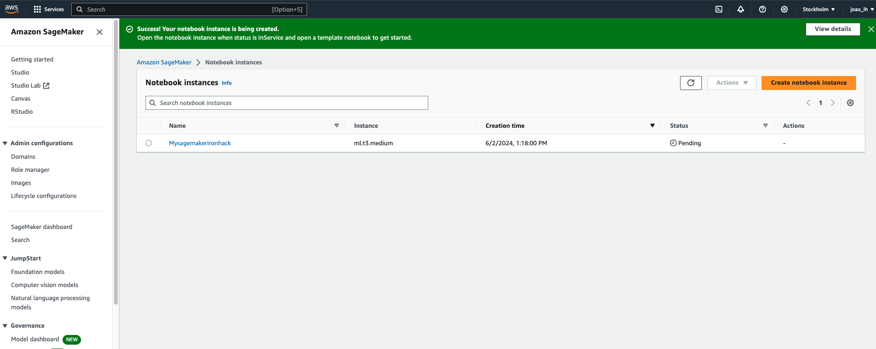
Login and run the code
Go to AWS
Log in
Search “SageMaker
Go to Notebook instances
Create notebook instance
Give it a name
(First time) create na IAM role
All other defaults are ok
SageMaker created!
Welcome

Slide 12
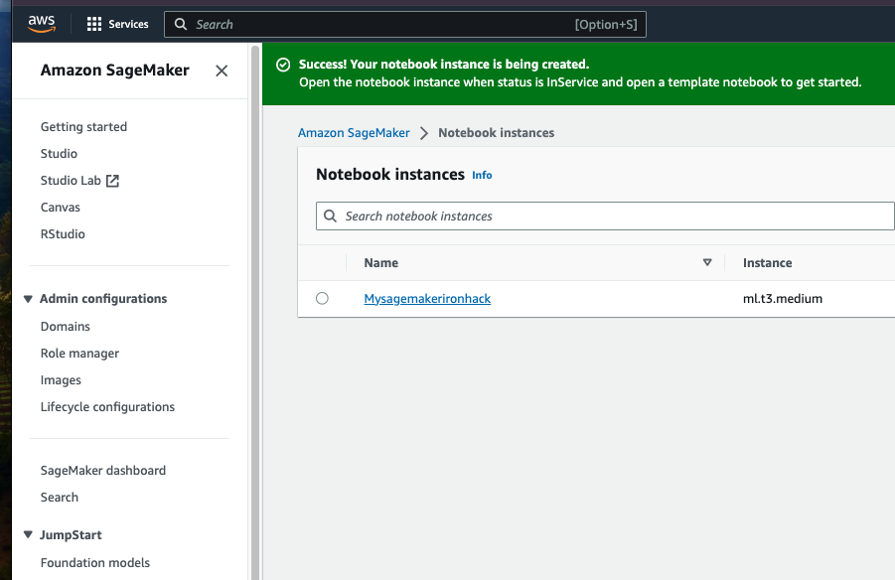
Login and run the code
Go to AWS
Log in
Search “SageMaker
Go to Notebook instances
Create notebook instance
Give it a name
(First time) create na IAM role
All other defaults are ok
SageMaker created!
Click the name to go in (it will take a few minutes)
Welcome

Slide 13
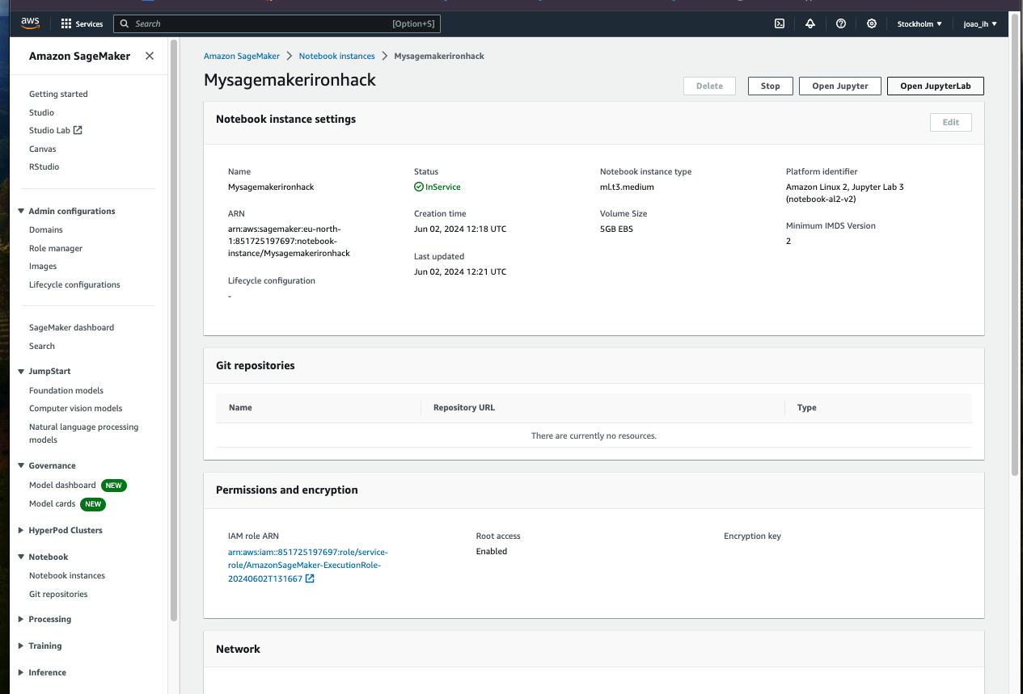
Login and run the code
Go to AWS
Log in
Search “SageMaker
Go to Notebook instances
Create notebook instance
Give it a name
(First time) create na IAM role
All other defaults are ok
SageMaker created!
Click the name to go in
Click Open Jupyter Lab
Welcome

Slide 14
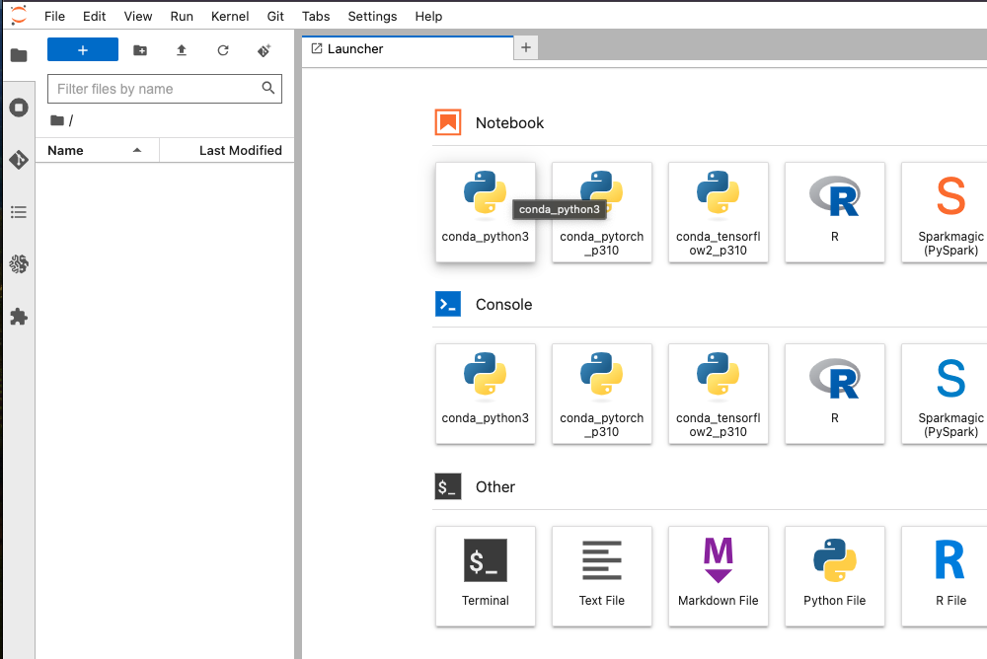
Login and run the code
Go to AWS
Log in
Search “SageMaker
Go to Notebook instances
Create notebook instance
Give it a name
(First time) create na IAM role
All other defaults are ok
SageMaker created!
Click the name to go in
Click Open Jupyter Lab
Click Conda Python3
Welcome

Slide 15
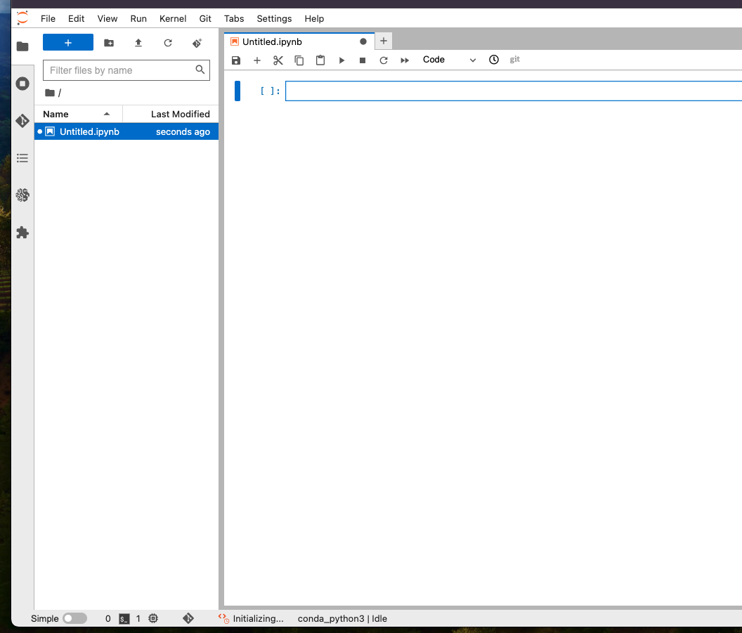
Login and run the code
Go to AWS
And you are in a jupyter notebook
as you know it. You can run terminal
commands by running !pip install as
well as upload documents and data to your
Notebook (via the upload button)
Be carefull with package instalation envs
and directories in general
Welcome

Slide 16
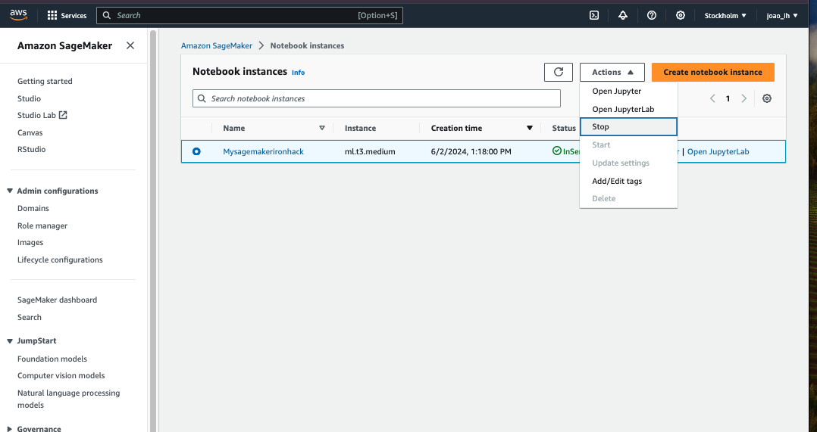
IMPORTANT
YOU HAVE TO STOP YOUR SAGEMAKER!!!!
IT costs 5cents/h which is nothing to run code,
but does pile up if you leave it active for 3 months!!!
Welcome

Slide 17
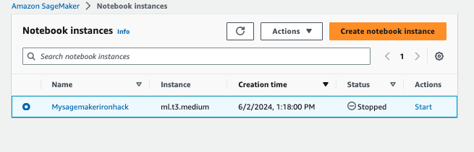
IMPORTANT
Stopped it looks like this
If you prefer, delete the instance
Welcome

Slide 18
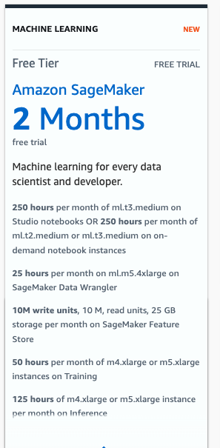
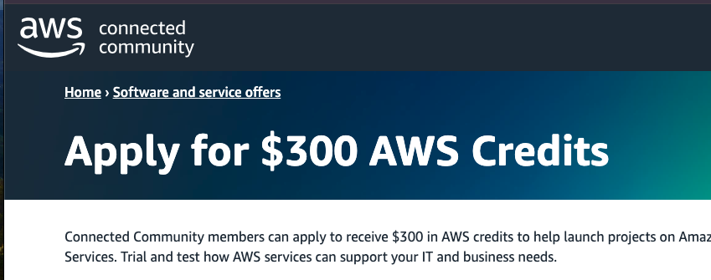
IMPORTANT
Amazon FreeTier:
- For 2 months (more than enough to finish the course)
You will have available some hours per month as well as you can apply to 300$ of AWS credits here:
https://aws-experience.com/amer/smb/exclusive-offers/aws-credits
NOTE: This is always chaning please confirm
Welcome

Slide 19
Exercises
Exercise 1):
- Get your code to run in AWS
Exercise 2)
- Get your code to Run on Google Colab (MUCH EASIER)
Bonus Exercise (if you feel like a techy guy)
- Create the similar thing as SageMaker but in Google Cloud Platform’s Vertex AI
https://cloud.google.com/vertex-ai/docs/workbench/instances/introduction
Welcome

Slide 20
Good luck
Let’s get started!

